Slide 1
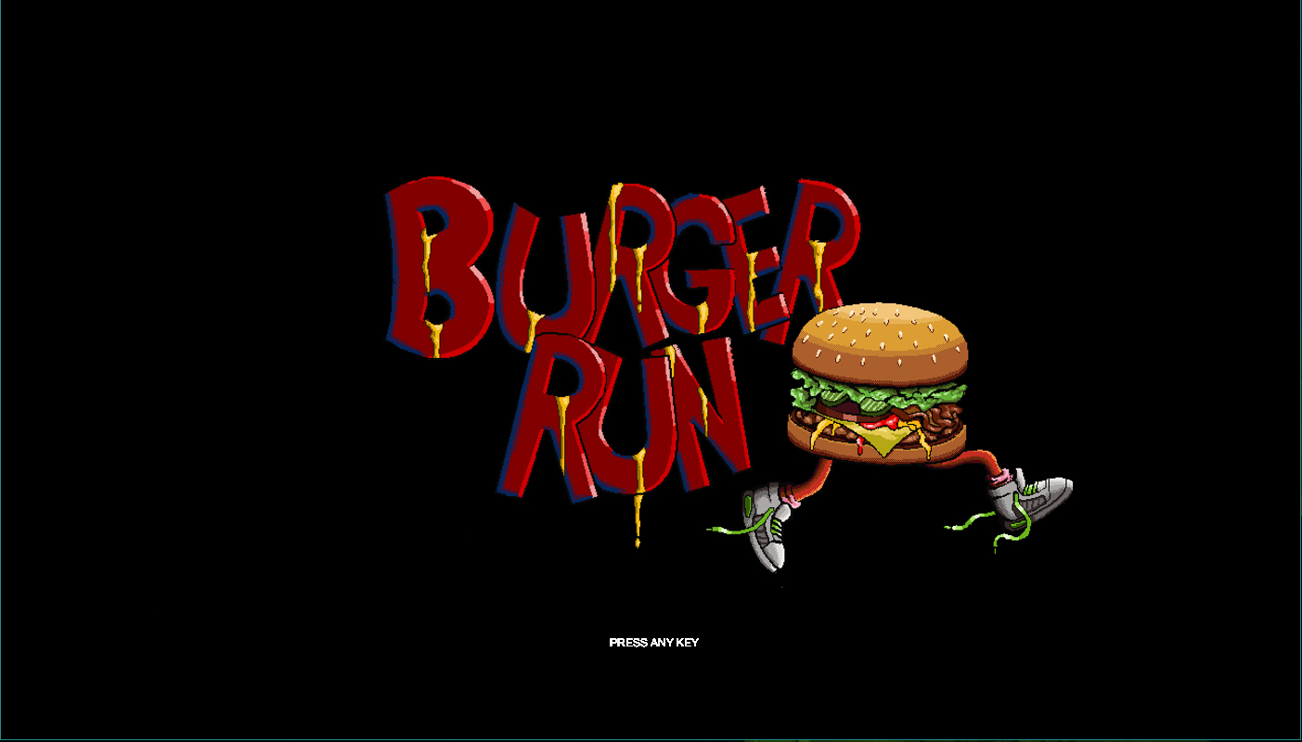

Slide 2
General Information
Written in Processing
Code contained among:
Main component
FindableObject component
Player component
Timer component
Standout features
Player is blind to the environment
Player is reliant upon flashlight for sight
Time sensitive
Difficulty settings
Background track
Object of the game
Collect all the ingredients to make a sandwich

Slide 3
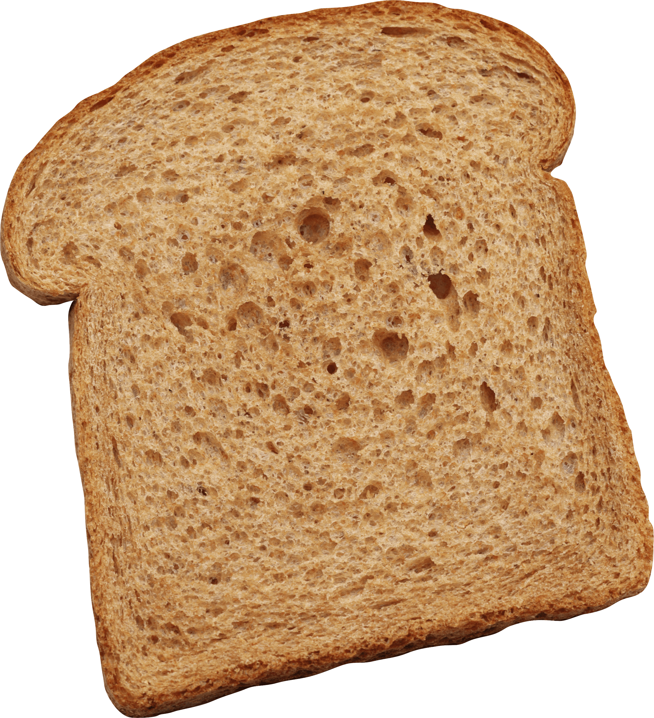
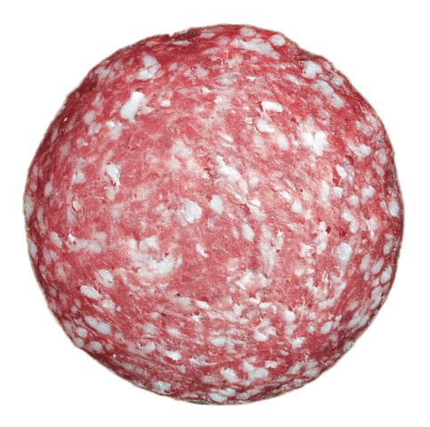

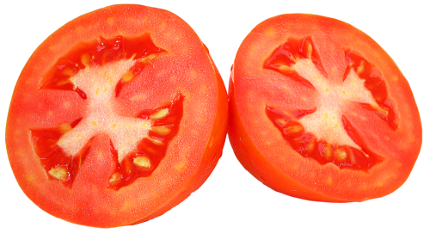

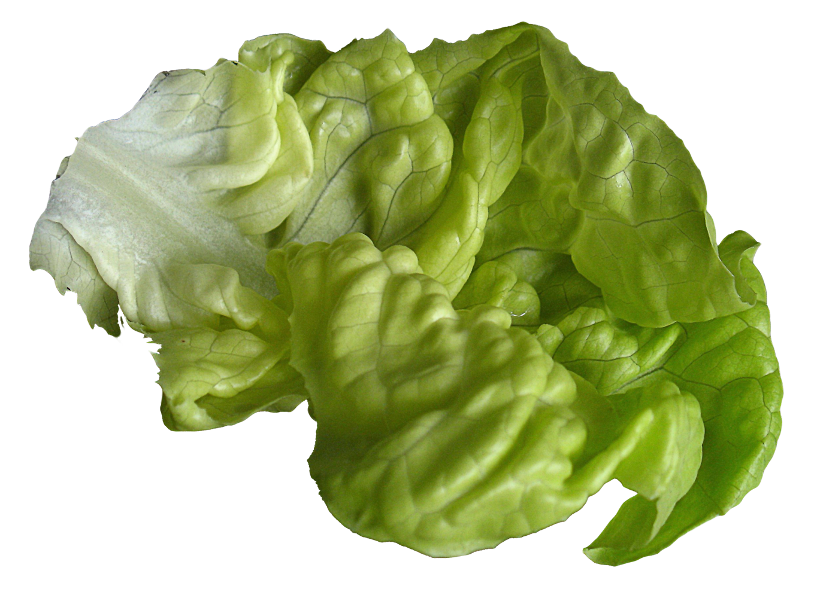
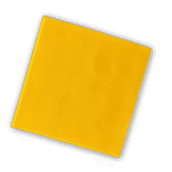
Sandwich Ingredients
Salami
Mayonnaise
Tomato
Bread
Onion
Cheese
Lettuce

Slide 4
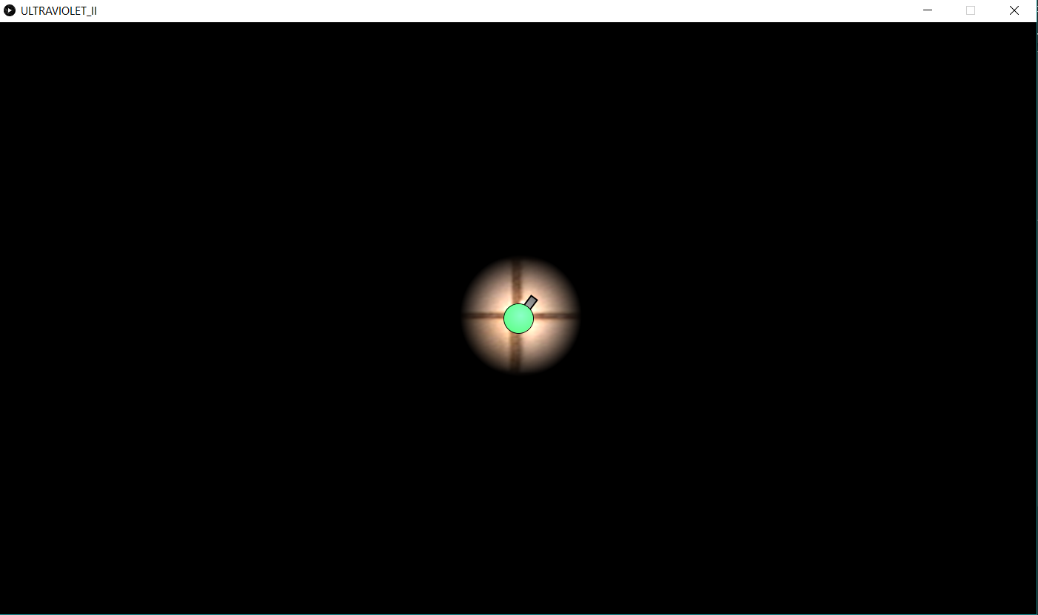
How to Play
Player controls:
Up, Left, Down, and Right arrows
W, A, S, D keys
Collect items by collision
Flashlight control:
Mouse movement
Shrinks in size with time left
Keep track of your location

